Slide 1
Empowering students to graduate, prepared to exceed all expectations

Slide 2
Message from the Principal
It's the end of the 3rd 9 weeks (this Friday), and Spring Break is in our vision! Finish up these 9 weeks strong, get some rest and relaxation over Spring Break, and prepare for the end-of-the-year craziness!

Slide 3
March 2025
Sun | Mon | Tue | Wed | Thu | Fri | Sat
26 | 27 | 28 | 29 | 30 | 31 | 1
2 | 3 | 4 | 5 | 6 | 7 | 8
9 | 10 | 11 | 12 | 13 | 14 | 15
16 | 17 | 18 | 19 | 20 | 21 | 22
23 | 24 | 25 | 26 | 27 | 28 | 29
30 | 31 | 1 | 2 | 3 | 4 | 5
3/7: Last day of the 9 Weeks
3/9: Daylight Savings, Adjust clocks ahead 1 hr.
3/12-3/10 Spring Break
3/17: First day of the last 9 weeks

Slide 4
Campus Events
01
02
03
04
TSU field Trip
TWC field trip
3/19/25
3/21/25
N.O.E.L mentoring group
Sistas mentoring group

Slide 5
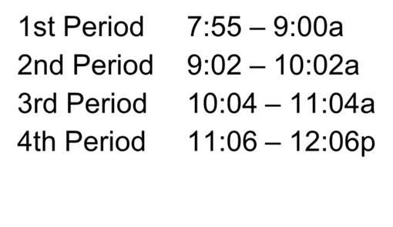
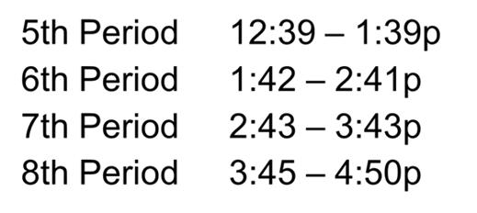
Bell Schedule
AM Session
PM Session
Please be on time to each class to make sure you are not counted absent. When you are absent from a class more than 4 days you are at risk of loosing credit.

Slide 6
February Perfect Attendance
Congratulations to our student who achieved Perfect Attendance for the month of February!
We appreciate you attending every day!!
Cortez Justin
Rodriguez Johnny
.Rushing Angel
Torres Jairo
Vasquez Brayan
Whitaker Jayden

Slide 7
PLEASE HELP US IMPROVE ATTENDANCE
When scheduling appointments, please try to schedule AFTER 2nd period for AM session or AFTER 6th period for PM session

Slide 8
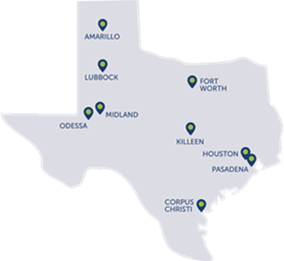
RMA Houston Celebrating Black History Month

Slide 9
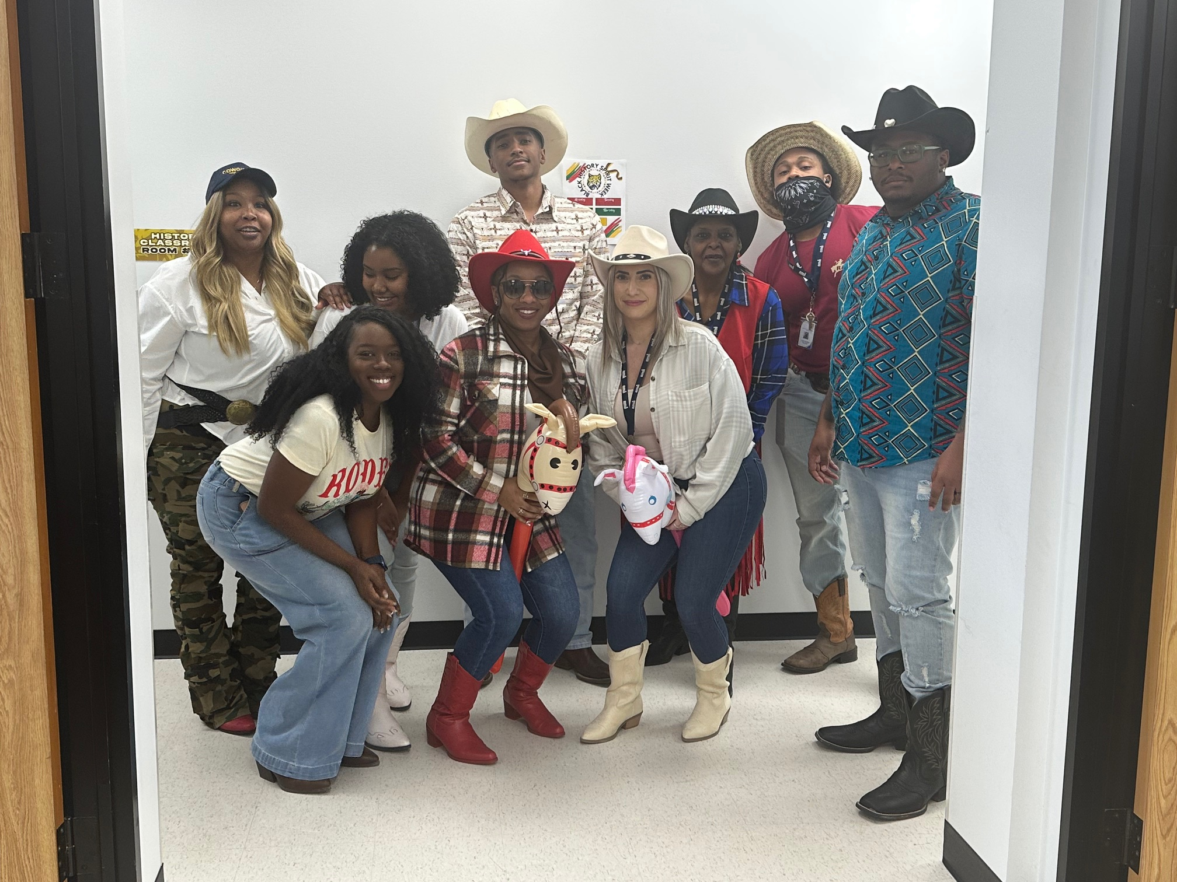
Go Texan Day!

Slide 10
Fat Tuesday

Slide 11
RMA Houston Rocking their Sunday best

Slide 12
Advice for High School Students: 11 Valuable Tips
Be Yourself
Embrace the Power of Networking
Improve Mental Health
Nurture Regular Study Habits
Explore Extracurricular Activities
Learn Time Management Skills
Set Goals
Take a Language Class
Explore Potential Career Paths
Take Advantage of School Resources
Learn New Skills Everyday

Slide 13
Resources for Seniors
FAFSA
Aging Matters Scholarship
Scholarship Listing
https://studentaid.gov/
https://www.seniorcare.com/scholarship/#apply_now
https://accessscholarships.com/blog/scholarships-for-high-school-seniors/
Scholarship Guidance
Texas Scholarships
Carlson Cares 2025 Scholarship
https://scholarshipguidance.com/newsletter
https://accessscholarships.com/scholarships-by-state/texas-scholarships/
https://www.carlsonattorneys.com/scholarship/

Slide 14
Upcoming STAAR TESTING Dates
Date | Subject | Date | Subject
4/8/25 | English 1 | 4/24/25 | Algebra 1
4/10/25 | English 2 | Tips for preparing for STAAR: - Get plenty of sleep the night before - Eat a balanced breakfast the day of test - Be confident
4/15/25 | Biology
4/16/25 | US History

